Slide 1
PSec
Sprint 2
Group 4

Slide 2
Topics for today
1
Sprint 2 review
What we had planned and what has been completed
2
Security decisions
The decisions we made in terms of security
3
UML diagrams
A detailed view of the project
4
User interface design
Visualization of PSec webapp and its functionality
5
Sprint 3 plans
What we are going to do next

Slide 3
Sprint 2 review
Create UML diagrams
Design user interface
Build and set up camera
Implement motion/sound detection
Sprint 3
Send text alerts
Notes:
We didn’t received hardware

Slide 4







Security decisions
Streaming
Internal storage
Video will be streamed through HLS (HTTP Live Streaming) and encrypted with AES-128
All recordings will be stored internally
Encryption
Closing ports
All traffic will use HTTPS, so it’s encrypted
Only port 443 (HTTPS) will be opened
Password
Input sanitisation
Passwords will be hashed, salted and peppered in the browser and again server side
Input will be sanitized to prevent SQL injection
Authorization
Local Database
The user will only be able to access their own video streams and cameras
Database will run on the Raspberry Pi
Notes:
https://stackoverflow.com/questions/16891729/best-practices-salting-peppering-passwords#16896216
A salt is a randomly generated value usually stored with the string in the database designed to make it impossible to use hash tables to crack passwords. As each password has its own salt, they must all be brute-forced individually in order to crack them; however, as the salt is stored in the database with the password hash, a database compromise means losing both.
A pepper is a site-wide static value stored separately from the database (usually hard-coded in the application's source code) which is intended to be secret. It is used so that a compromise of the database would not cause the entire application's password table to be brute-forceable.

Slide 5
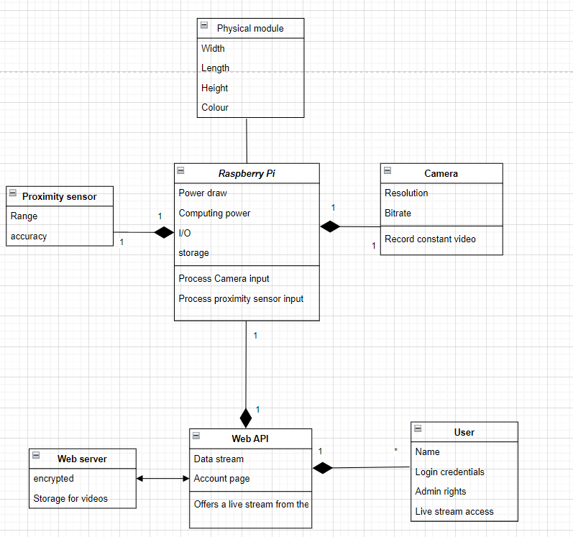
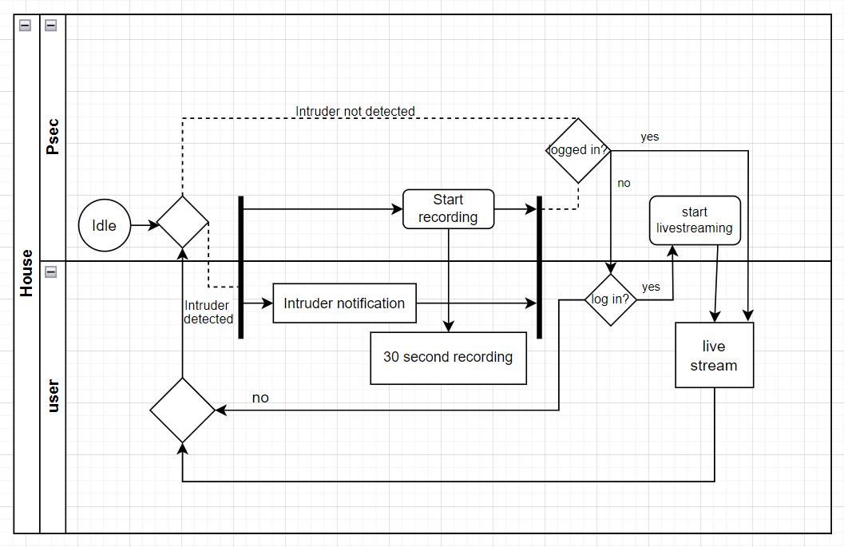
UML Diagrams
Class diagram
Activity diagram

Slide 6
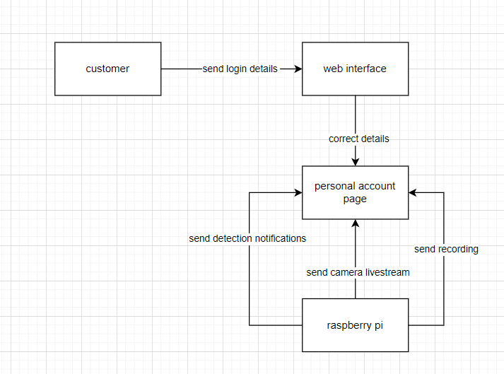
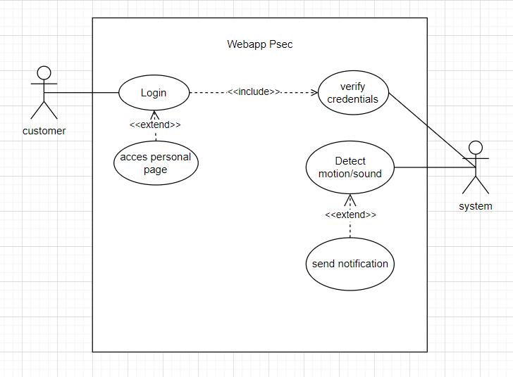
UML Diagrams
Data flow diagram
Use case diagram

Slide 7
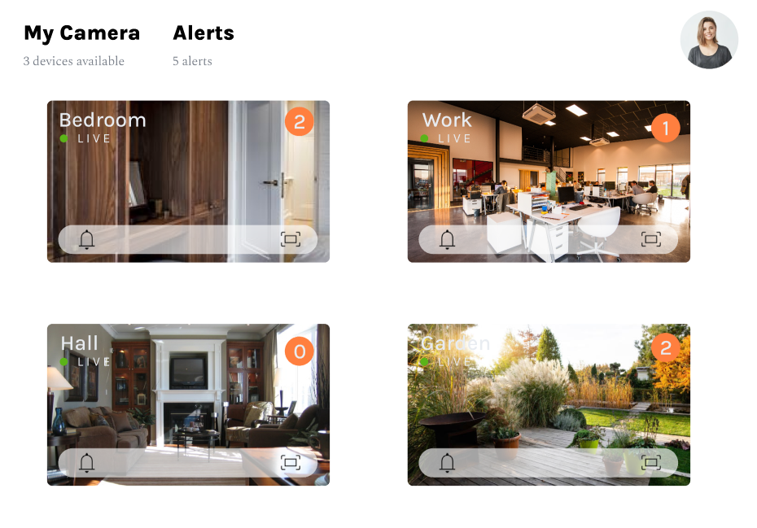
UI design
Main page with overview of all the spaces (in our case only one space according to the limitations presented earlier), quick access to the alerts info and livestream.

Slide 8
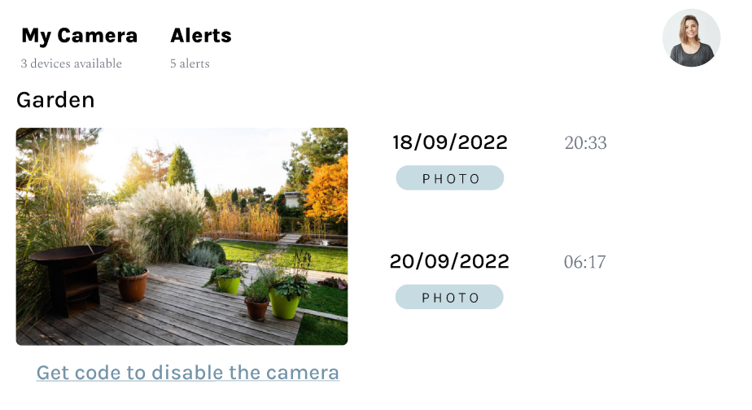
UI design
Individual camera page. Provides access to the livestream of the area, overview of the previous alerts with an option to access the photo. Also contains a link that provides a randomly generated temporary code that allows the user to disable the camera.

Slide 9
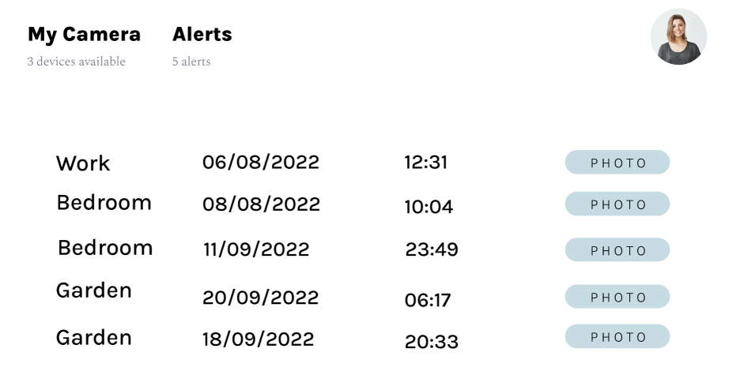
UI design
The Alerts page. Provides the list of all the alerts with the information about the area name, date and time of alert and a link to access the photo taken after the motion was detected.

Slide 10
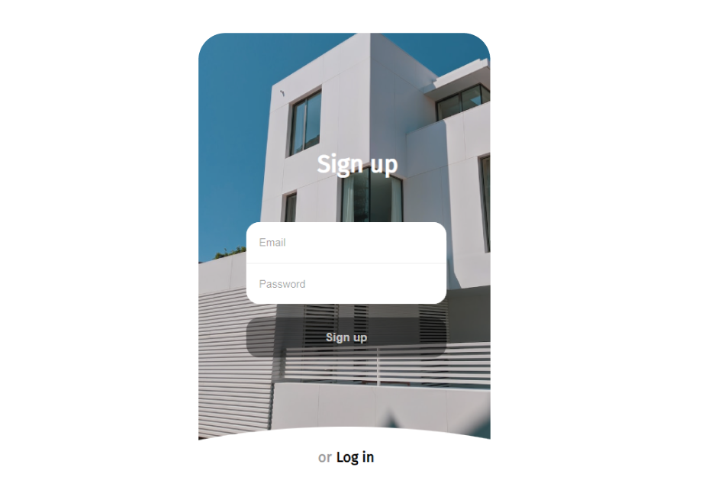
UI design
Sign up/Log in page. Required to authorize a user so that to have access to their personal digital space and its functionality. Needed to ensure security of the stored data and privacy of the users’ data (sign up to setup the PSec digital space).

Slide 11
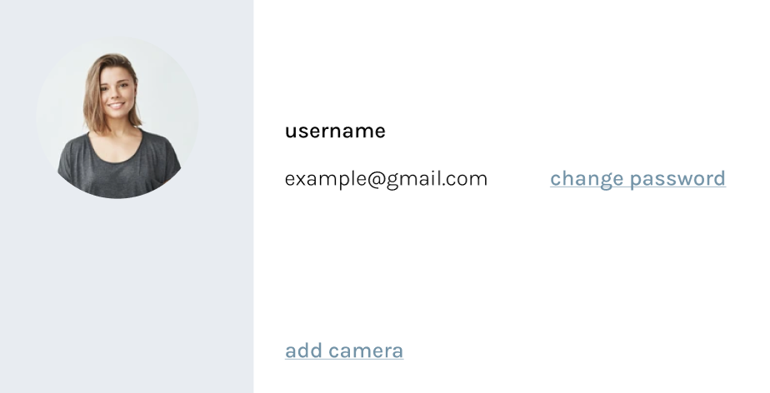
UI design
Profile page. Allows the user to change their password.

Slide 12
Sprint 3 planning
Send alerts to web app
Add account authorisation
Enable livestream and allow program to store video/photos/
sounds
Build and setup the device
Implement sound/motion detection

Slide 13
Q&A

